Slide 1

Database
PROGRAMMING
Using SQL
Notes:
To use this title animation slide with a new image simply 1) move the top semi-transparent shape to the side, 2) delete placeholder image, 3) click on the picture icon to add a new picture, 4) Move semi-transparent shape back to original position, 5) Update text on slide.

Slide 2
“As a student, I would like to understand what a database is.“

Slide 3
A TOOL THAT STORES DATA AND LETS YOU CREATE, READ, UPDATE, AND DELETE DATA
DATABASE
Examples of “non traditional” databases
Business cards
Phone book
Notebook
File cabinet
“Brain” – the most sophisticated database in existence!

Slide 4
NON-TRADITIONAL DATABASE Advantages
1
2
3
4
5
Protected from power failures
Data is fairly safe from digital theft and breaches
Usually inexpensive to buy
Simple for most people to use
Easy to add, edit, remove information

Slide 5
NON-TRADITIONAL DATABASE Disadvantages
1
2
3
4
5
May hold incomplete or incorrect information (redundancy)
Data is physically easy to steal or lose
Correcting large data errors can be problematic
Slow at creating, retrieving, updating, and deleting information
Not easily shared
Reference : The basics you can find anywhere 5 Steps To Successful Storytelling Published on April 5, 2014 Featured in: Marketing & Advertising

Slide 6
INTRODUCING
Electronic Database
Electronic database have these desired features:
Portability
Security
Sharing
Complex calculations
Atomicity
Consistency
Isolation
Durability
CRUD
Consistency
Validity
Speed
Persistence and Backups
Low cost and extensibility
Ease of Use

Slide 7
“As a student, I would like to know different types of file storage mechanisms that may be used as databases.”

Slide 8
TYPES
Recognize the different file types to better understand when to use them
Flat files
Text files, INI files, Registry files
“Spreadsheets
Excel files, CSV
XML
XML format
JSON
JavaScript Notation
Relational
SQL Server, Oracle, PostgreSQL…
NoSQL
MongoDB, CouchDB
And many more…

Slide 9
“As a student, I would like to understand what normalization is so that I can create my first database.”

Slide 10
Normalization
Is a step-by-step process used to determine which data elements should be stored in which tables with the purpose of Eliminating data redundancy
Normal Forms
Eliminates repeating groups
Identify primary key (usually composite)
1st
1st NF
Remove partial dependencies
2nd
2nd NF
Remove transitive dependencies
3rd
Online transaction processing (OLTP) developers usually normalize to 3rd Normal Form (NF)

Slide 11
“As a student, I would like to create an Entity Relational Diagram (ERD) to begin creating my new inventory management system.”

Slide 12
ERD
Designed to help you identify which entities need to be included in database
Student
Course
StudentID
CourseID
1
1
StudentCourse
StudentID
CourseID
∞
∞
Entity
(rectangle box)
Junction Table
Relationship
(line)
Relationship Types:
1 : 1 – One to One
1 : M (∞) – One to Many
M (∞) : M(∞)– Many to Many
Entity Relational Diagram

Slide 13
“As a student, I would like to know how to use SQL Server Management Studio to write my SQL statements for my new system.”

Slide 14
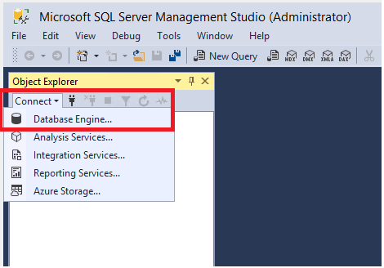
1
Management Studio is made up of a number of tools.
CONNECT
This gets you connected to your database service from your AWS account.

Slide 15
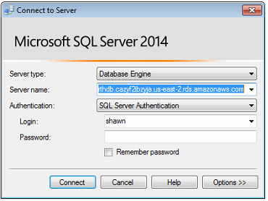
2
Enter the credentials created in when you set up the RDS account.
LOGIN
*Be sure to use SQL Server Authentication

Slide 16
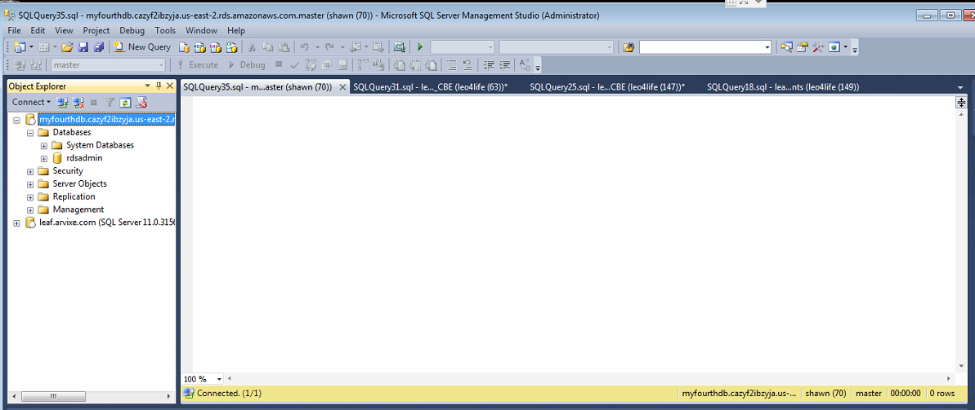
3
Select ‘New Query’ to get to Query Analyzer tool
We will live in this area of SQL Server for the duration of the course
Notes:
Tip:
When using complex image as full-bleed background add a transparency (70%-90%) fill layer to give contrast to text.

Slide 17

4
Let the fun begin!
ENJOY
Approach with no fear
Don’t be afraid to try things, we can easily recreate the entire environment!
Take advantage of this opportunity to learn

